Slide 1
Mastering System Design
Section 3: Protocols
Networking & Communication

Slide 2
Section Agenda
Lecture 1: TCP & UDP - Understanding the Basics
Lecture 2: HTTP - The Backbone of the Web
Lecture 3: REST & RESTfulness - API Design Principles
Lecture 4: Real-Time Communication Protocols
Lecture 5: Modern API Protocols - Beyond REST
Lecture 6: Summary & Practical Applications

Slide 3
TCP & UDP
Protocols

Slide 4
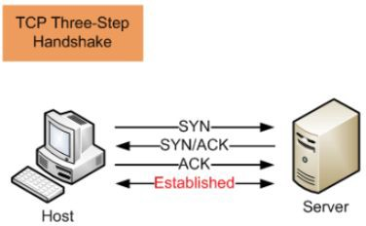
What is Transmission Control Protocol (TCP)?
Connection-oriented protocol
Reliable, ordered, and
error-checked communication
Ensures data reaches the destination correctly

Slide 5
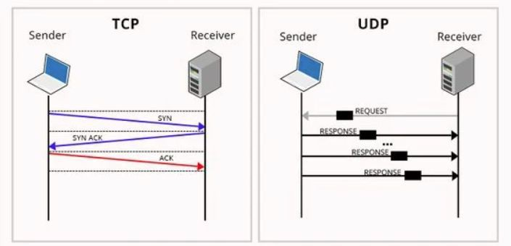
What is User Datagram Protocol (UDP)?
Connectionless protocol
Faster, but no delivery guarantees
No retransmission of lost packets

Slide 6
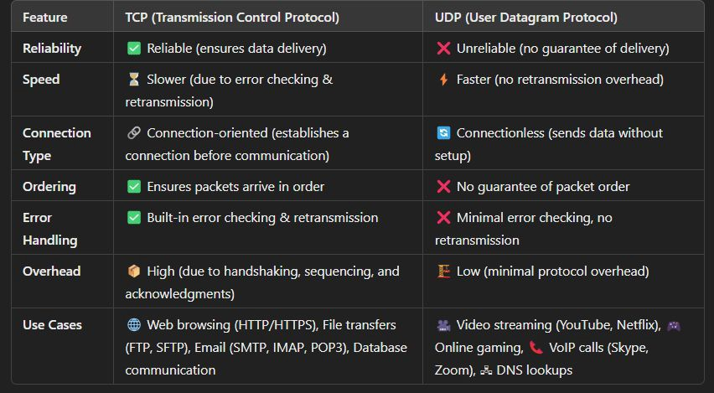
Key Differences Between TCP & UDP
Reliability: TCP (Yes), UDP (No)
Speed: TCP (Slower), UDP (Faster)
Connection Type: TCP (Connection-oriented), UDP (Connectionless)

Slide 7
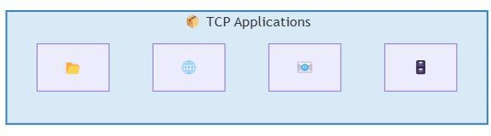
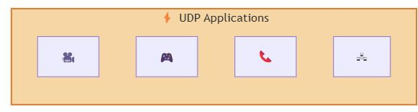
Use Cases: When to Use TCP vs. UDP
When to use TCP: If data integrity is critical, TCP is the way to go.
  Web browsing (HTTP, HTTPS)
  File transfers (FTP, SFTP)
  Email (SMTP, IMAP, POP3)
  Database communication
When to use UDP: UDP is preferred when speed is more important than reliability
  Video streaming (YouTube, Netﬂix)
  Online gaming (Multiplayer Games)
  VoIP calls (Skype, Zoom)
  DNS lookups (Domain Name System)

Slide 8
Interview Questions: TCP & UDP
Basic Questions:
  What is the diﬀerence between TCP and UDP?
  Why is TCP considered a reliable protocol?
  When would you choose UDP over TCP?
Technical & Deep-Dive:
  How does TCP ensure reliable data transmission?
  What is the Three-Way Handshake in TCP?
  How does UDP handle packet loss?
Use Case & System Design:
  Which protocol would you use for a real-time multiplayer game? Why?
  How does TCP handle congestion control?
  Why is DNS implemented over UDP instead of TCP?
  If a video streaming service is buﬀering too much, would switching from TCP to UDP help?
Pro Tip: Be prepared to compare TCP & UDP in real-world scenarios and discuss trade-oﬀs in speed vs. reliability!

Slide 9
Summary & Key Takeaways
TCP is reliable but slower; UDP is fast but unreliable.
TCP is best for web pages, ﬁle transfers, and email.
UDP is best for real-time applications like video calls and gaming.
System design must balance speed, reliability, and user experience.
What’s Next:
  HTTP - The Backbone of the Web

Slide 10
HTTP - The Backbone of the Web
Protocols

Slide 11
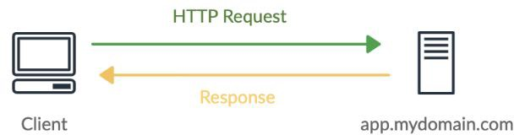
Introduction to HTTP
What is HTTP?
  Stands for HyperText Transfer Protocol
  The foundation of web communication
  Deﬁnes rules for requesting and transferring resources (e.g., web pages, APIs, images)
  Works over TCP/IP (Port 80 for HTTP, Port 443 for HTTPS)
Key Features:
  Text-based protocol (easy to read & debug)
  Stateless (each request is independent)
  Supports multiple methods (GET, POST, etc.)

Slide 12
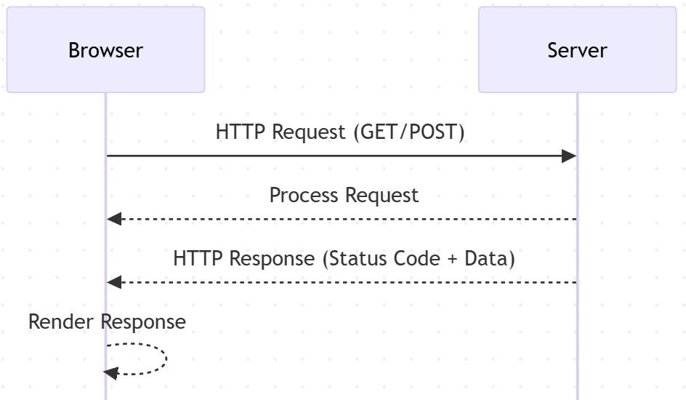
How HTTP Works
Client-Server Model:
  Client (browser or mobile app) makes an HTTP request
  Server (web server, API, etc.) processes the
request and sends back a response
Components of an HTTP Request:
  Method: Deﬁnes the action (GET, POST, etc.)
  URL: The resource being requested
  Headers: Metadata (e.g., user-agent, content type)
  Body (optional): Data sent in POST/PUT
requests
Components of an HTTP Response:
  Status Code: Indicates success or failure (e.g., 200 OK, 404 Not Found)
  Headers: Metadata about the response
  Body (optional): The actual content returned

Slide 13
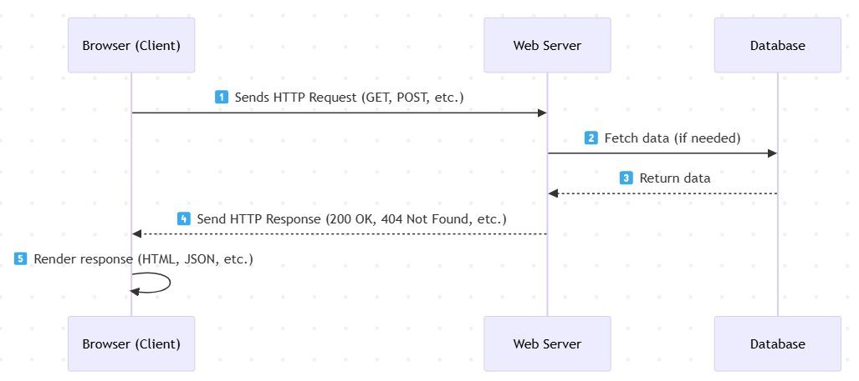
The HTTP Request-Response Cycle
Step 1: The browser (client) sends a request
Step 2: The web server processes the request
Step 3: The server generates a response and sends it back
Step 4: The browser renders the response (for a web page)

Slide 14
Stateless Nature of HTTP
What does “stateless” mean?
  HTTP does not retain memory of previous requests
  Each request is treated as an independent transaction
Challenges of Statelessness:
  Hard to maintain user sessions (e.g., login state)
  Each request must carry all necessary information
How do we handle state?
  Cookies – Small pieces of data stored in the browser
  Sessions – Server-side storage of user state
  Tokens (JWT, OAuth) – Used for authentication & authorization

Slide 15
HTTP Methods
Common HTTP Methods & Their Use Cases:
  GET: Retrieve a resource (e.g., webpage, API data)
  POST: Send data to create a new resource (e.g., form submission)
  PUT: Update an existing resource
  DELETE: Remove a resource
  PATCH: Partially update a resource

Slide 16
HTTP Status Codes
1xx – Informational (Request received, continuing process)
2xx – Success (Request successfully processed)
  200 OK – Successful response
  201 Created – Resource successfully created
3xx – Redirection (Further action needed)
  301 Moved Permanently – Resource URL changed
  304 Not Modiﬁed – Use cached version
4xx – Client Errors (Mistakes in the request)
  400 Bad Request – Incorrect request format
  401 Unauthorized – Authentication required
  403 Forbidden – No permission
  404 Not Found – Resource doesn’t exist
5xx – Server Errors (Issue with the server)
  500 Internal Server Error – Unexpected server failure
  503 Service Unavailable – Server overloaded

Slide 17
What About HTTPS?
HTTPS is the secure version of HTTP, using SSL/TLS encryption.
It ensures data conﬁdentiality, integrity, and authentication.
Used for secure websites, online banking, and e-commerce.
Works on Port 443 instead of Port 80.

Slide 18
HTTP Interview Questions
Basic Questions:
  What is HTTP, and how does it work?
  Why is HTTP considered a stateless protocol?
  What are the key diﬀerences between HTTP and HTTPS?
Intermediate Questions:
  Explain the HTTP request-response cycle with an example.
  What are HTTP methods? When would you use PUT vs. PATCH?
  What are HTTP status codes? Give examples of 2xx, 3xx, 4xx, and 5xx status codes.
Advanced Questions:
  How do cookies, sessions, and tokens help maintain state in HTTP?
  What is the diﬀerence between 301 (Moved Permanently) and 302 (Found) redirections?
  How does caching work in HTTP, and which headers control it?
  What security risks are associated with HTTP, and how can they be mitigated?

Slide 19
Summary & Key Takeaways
HTTP is the foundation of web communication
It follows a request-response model
HTTP is stateless, requiring mechanisms like cookies & sessions
HTTP methods deﬁne actions, and status codes indicate responses
What’s Next:
  REST & RESTfulness - API Design Principles

Slide 20
REST & RESTfulness - API Design Principles
Protocols

Slide 21
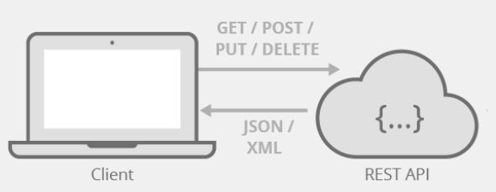
What is REST?
Deﬁnition: REST (Representational State Transfer) is an architectural style for designing networked applications.
Key Idea: Uses standard HTTP methods and stateless communication.
Origin: Coined by Roy Fielding in his 2000 dissertation.

Slide 22
Why REST Matters?
Simplicity & Scalability: Based on standard HTTP.
Interoperability: Works across diﬀerent platforms.
Eﬃciency: Uses caching, statelessness for performance.

Slide 23
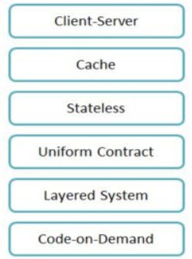
REST Constraints (Core Principles)
Client-Server Architecture
Statelessness
Cacheability
Layered System
Uniform Interface

Slide 24


RESTful API Design Principles
Resource-Based Approach
  GET /users/{id} to retrieve a user
  POST /orders to create a new order
Proper HTTP Methods Usage
  GET to retrieve data
  POST to create new resources
  PUT to update existing resources
  PATCH for partial updates
  DELETE to remove resources
Stateless Interactions
Consistency in URL Structure
Use plural nouns for collections: /users, /orders
○
○
Avoid including actions in URLs: /users/{id}/activate
Implement versioning for backward compatibility: /v1/users
→ /users/{id} with PATCH

Slide 25
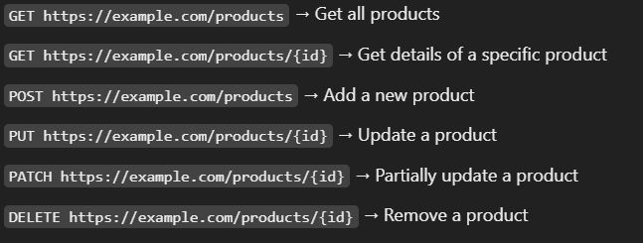
Resources & Endpoints
Resources: Entities like Users, Orders, Products.
Endpoint Examples:
  GET /users/{id}
  POST /orders
  DELETE /products/{id}

Slide 26

JSON vs. XML in REST APIs
Why JSON?
  Lightweight
  Faster parsing
  Readable
When to Use XML?
  Legacy systems
  Data validation needs

Slide 27
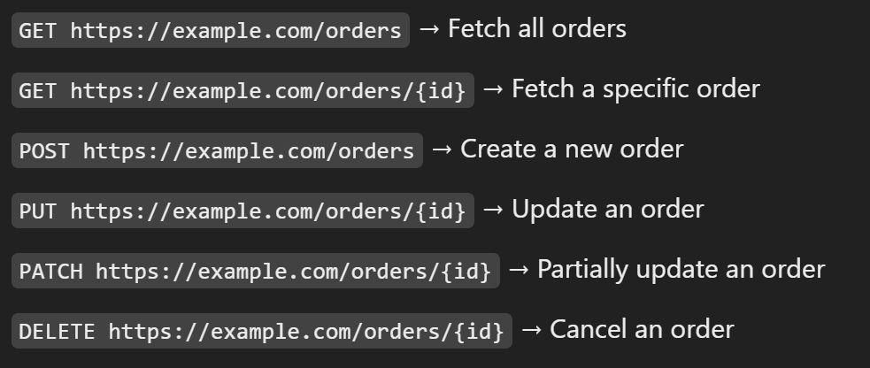
HTTP Methods in REST
GET: Retrieve data
POST: Create a resource
PUT: Update a resource
PATCH: Partial update
DELETE: Remove a resource
OPTIONS, HEAD: Additional functionalities

Slide 28
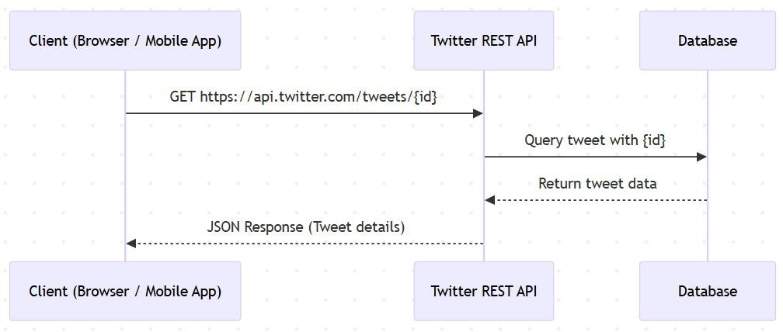
Real-World REST API Examples
Twitter API
  Fetch tweets: GET /tweets/{id}
  Post a tweet: POST /tweets
GitHub API
  Get repo details: GET
/repos/{owner}/{repo}
  Create an issue: POST
/repos/{owner}/{repo}/issues

Slide 29

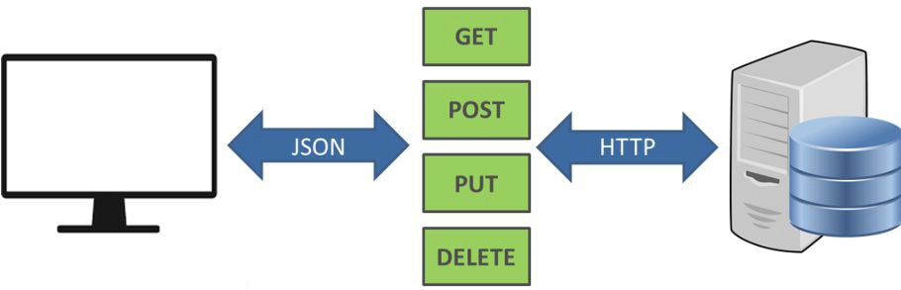
Best Practices & Common Pitfalls
Use Proper Status Codes (200, 201, 400, 404, 500)
Versioning APIs (/v1/resource) Implement Authentication (OAuth, JWT) Pagination (?page=2&limit=20)
Avoid using Verbs in URLs (/createUser → POST /users)

Slide 30
Interview Questions - REST
Basic Questions
  What is REST, and how does it diﬀer from SOAP?
  What are the six constraints of REST architecture?
  What is the diﬀerence between a REST API and a RESTful API?
  What is a resource in REST, and how is it represented?
  What are endpoints in a REST API?
TP Methods & Status Codes
  Explain the diﬀerence between GET, POST, PUT, PATCH, and DELETE.
  When would you use PUT vs. PATCH?
  What are the commonly used HTTP status codes in REST APIs?
  What does the 200 OK, 201 Created, 204 No Content, 400 Bad Request, 401 Unauthorized, 403 Forbidden, 404 Not Found, and 500 Internal Server Error mean?
RESTful API Design & Best Practices
What are the best practices for designing RESTful APIs?
How do you design a RESTful API for a blogging platform (e.g., users, posts, comments)?
What is HATEOAS (Hypermedia as the Engine of Application State) in REST?
How do you handle authentication and authorization in REST APIs?
What are API rate limiting and throttling, and why are they important?
○
How do you ensure backward compatibility when updating a REST API?
Advanced & Real-World Questions
  How does caching work in RESTful APIs?
  What is the diﬀerence between JSON and XML in REST?
  How do you implement pagination in REST APIs?
  How does versioning work in REST APIs?
  Explain the diﬀerences between REST, GraphQL, and gRPC.
  How would you improve the performance of a REST API?
  Can a REST API be stateful? Why or why not?
  How does REST handle security vulnerabilities like SQL injection and CSRF?

Slide 31
Summary & Key Takeaways
REST is a stateless, scalable, and widely adopted API design style.
Proper endpoint structure, HTTP methods, and response formats matter.
Security, versioning, and best practices improve API quality.
What’s next:
  Real-Time Communication Protocols

Slide 32
Real-Time Communication Protocols
Protocols

Slide 33
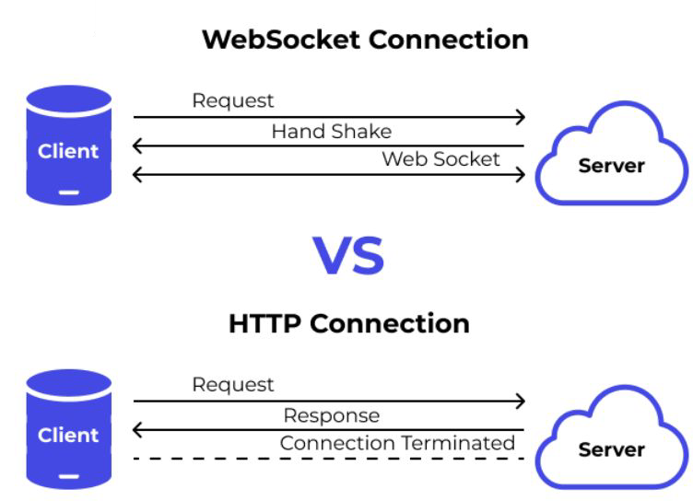
Introduction to Real-Time Communication
Deﬁnition: Real-time communication refers to the continuous exchange of data with minimal latency.
Why real-time is important (e.g., instant chat, live stock updates, multiplayer games).
Challenges of traditional request-response HTTP model.
Traditional HTTP vs. Real-Time Communication
Alternatives to improve real-time data exchange:
  Polling
  WebSockets
  Server-Sent Events (SSE)
  Long Polling

Slide 34
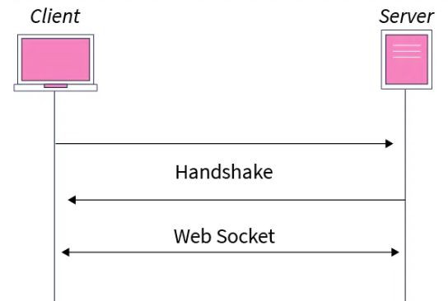
WebSockets: Persistent Full-Duplex Communication
Deﬁnition: WebSockets provide a persistent, full-duplex connection between the client and server over a single TCP connection.
How they work:
  WebSocket handshake using HTTP upgrade request.
    Step 1: Client requests an upgrade to WebSockets
    Step 2: Server accepts and keeps the connection open.
  Connection remains open for continuous data exchange.
  Either client or server can send messages at any time.
    Step 3: Data is exchanged in real-time using frames.
    Step 4: Either party can close the connection when done.

Slide 35

Advantages and use cases of WebSockets
Advantages:
  Persistent connection = lower latency.
  Reduces overhead compared to HTTP polling.
  Eﬃcient for real-time applications.
Use cases:
  Live Chat Applications (WhatsApp, Slack, Discord)
  Stock Market Price Updates (NASDAQ, Robinhood)
  Multiplayer Online Games (Fortnite, Call of Duty)
  Collaborative Tools (Google Docs, Figma)

Slide 36
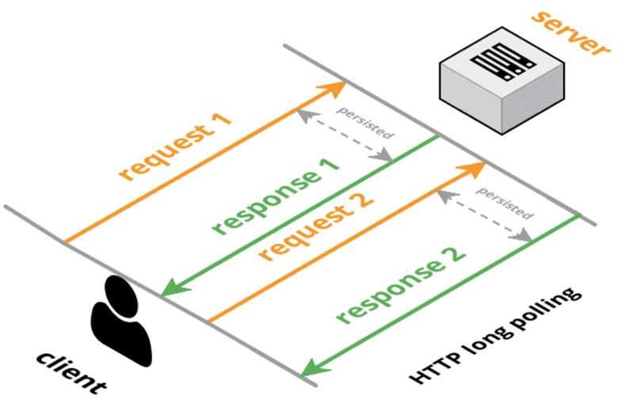
Long Polling: Simulating Real-Time with HTTP
Deﬁnition: A technique where the client sends a request to the server and waits until the server has new data to respond with.
How it diﬀers from regular polling:
Instead of immediate responses, the server holds the request until new data is available.
How Long Polling Works (Step-by-Step)
  Client makes an HTTP request.
  Server holds the request until data is available.
  Server responds with new data.
  Client immediately sends another request.

Slide 37
When to Use WebSockets vs. Long Polling?
Use WebSockets when:
  High-frequency, bi-directional data exchange is needed.
  Low latency is critical (e.g., gaming, chat).
Use Long Polling when:
  WebSockets are not supported or overkill.
  Periodic updates are suﬃcient (e.g., notiﬁcations).
Real-world example:
  Slack: WebSockets for chat.
  Twitter: Long Polling for notiﬁcations.
  Stock Exchanges: WebSockets for real-time data feeds.
  IoT devices: Long Polling for intermittent updates.

Slide 38
Interview Questions
Basic Questions
  What is real-time communication, and why is it important?
  How does WebSockets work, and how does it diﬀer from traditional HTTP?
  Explain the WebSocket handshake process.
  What is long polling, and how does it work?
Intermediate Questions
  What are the advantages of WebSockets over long polling?
  In what scenarios would you prefer long polling over WebSockets?
  How does WebSockets handle connection failures or network interruptions?
  Can you use WebSockets with load balancers? If yes, how?
  What are some challenges of scaling WebSockets in a distributed system?

Slide 39
Summary & Final Takeaways
WebSockets = Persistent, full-duplex communication.
Long Polling = Simulated real-time via HTTP requests.
Choose based on latency needs and infrastructure.
What’s next:
  Modern API Protocols - Beyond REST(gRPC, GraphQL)

Slide 40
Modern API Protocols - Beyond REST(gRPC, GraphQL)
Protocols

Slide 41

Why Do We Need More Than REST?
Limitations of REST APIs:
  Over-fetching & Under-fetching (Clients get too much or too little data).
  High Latency (Multiple requests needed for complex data).
  Not optimized for real-time communication (Polling required).
Need for modern solutions like gRPC & GraphQL to handle eﬃciency, ﬂexibility, and performance.

Slide 42
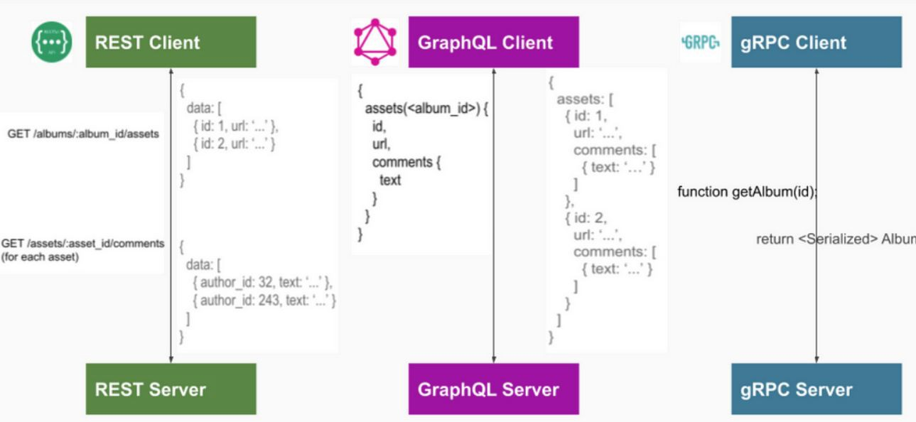
Introducing gRPC & GraphQL
gRPC: A high-performance, binary protocol optimized for microservices & real-time communication.
GraphQL: A ﬂexible query language that allows clients to fetch only the data they need.
Key Diﬀerences:
  gRPC = Fast, binary, microservices-focused
  GraphQL = Flexible, JSON-based,
frontend-optimized

Slide 43
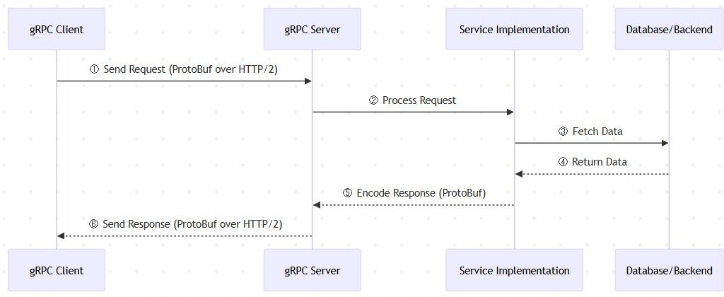
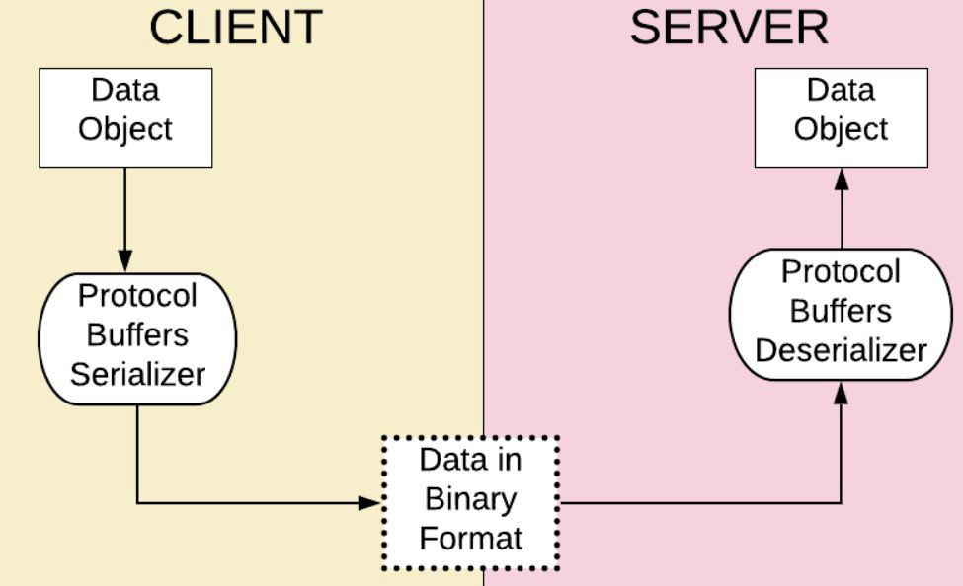
gRPC - How It Works?
gRPC is built on HTTP/2, allowing:
  Multiplexed requests (multiple calls over one connection).
  Compression (smaller payload sizes).
  Full-duplex streaming (real-time bidirectional communication).
Uses Protocol Buﬀers (ProtoBuf) for fast serialization (smaller & faster than JSON).

Slide 44
gRPC - Use Cases & When to Use
Microservices – Fast inter-service communication.
Real-time streaming – Full-duplex bidirectional data transfer.
IoT & Low-bandwidth applications – Eﬃcient binary communication.
Multi-language ecosystems – Auto-generated client & server code.

Slide 45
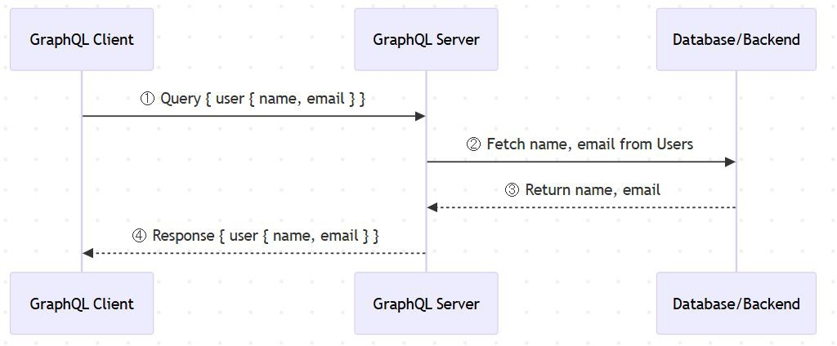
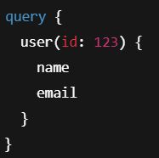
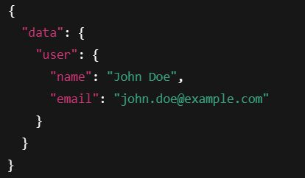
GraphQL - How It Works?
Instead of multiple REST endpoints, GraphQL has one endpoint where clients specify the data they need.
GraphQL Schema deﬁnes types & relationships between data.
Clients send queries → GraphQL server resolves ﬁelds dynamically.

Slide 46
GraphQL - Use Cases & When to Use
Frontend Optimization – Clients fetch exactly what they need.
Reducing API Requests – One query replaces multiple REST calls.
Mobile & Web Apps – Handles slow networks & multiple data sources.
Aggregating Data from Multiple Services – Simpliﬁes fetching data from diﬀerent databases or APIs.

Slide 47
Interview Questions on API Protocols
How would you compare REST, gRPC, and GraphQL?
When would you use gRPC over REST?
What are the trade-oﬀs of using GraphQL in a large-scale system?
How does gRPC handle authentication & security?
How do you scale GraphQL APIs eﬃciently?

Slide 48
Summary & Key Takeaways
gRPC → Best for microservices, real-time streaming, high-performance APIs.
GraphQL → Best for frontend-driven APIs, ﬂexible data fetching, and reducing over-fetching.
Choose based on use case – No one-size-ﬁts-all!
Be ready to justify your API choices in system design interviews!
What’s next:
  Summary & Practical Applications of protocols

Slide 49
Summary - Protocols
In this section, we explored key communication and API design protocols essential for system design:
  TCP & UDP - Understanding the Basics
  HTTP - The Backbone of the Web
  REST & RESTfulness - API Design Principles
  Real-Time Communication Protocols
  Modern API Protocols - Beyond REST
Next Up:
  Architectural Patterns
  We now shift focus to architectural patterns, which deﬁne how components interact in scalable systems.

